Slide 1





CS THESIS FINAL PRESENTATION
OPTIMIZING CUSTOMER RETENTION: COMPARING THE EFFICACY OF MULTIPLE MACHINE LEARNING TECHNIQUES IN PREDICTING E-COMMERCE CHURN
Presentation By Godfred Kogkane
May 12, 2025
Supervisor | Prof. Robert Sowah Adjetey

Slide 2

OVERVIEW
INTRODUCTION & PROBLEM
RESEARCH GOAL & QUESTIONS
METHODOLOGY
EVALUATION METRICS
RESULTS & PERFORMANCE
EFFICIENCY & STATISTICAL TESTING
RECOMMENDATIONS
FUTURE WORK
CONCLUSION
REFERENCE
THANK YOU

Slide 3



Introduction & Problem
Introduction
According to Chevalier (2024), global e-commerce sales were $5.8 trillion in 2023 and are projected to reach $8.1 trillion by 2026 [2].
However, customer churn remains a major challenge—studies show churn rates can range from 20% to 80% depending on the platform.
Problem
Reichheld and Schefter (2000) note that a 5% increase in customer retention can lead to more than a 25% increase in profits [1].
Despite the rise of machine learning in customer analytics, many models are poorly compared, with limited attention to deployability or metrics like MCC.

Slide 4





Goal
To provide insights into the most effective, scalable ML models tailored to customer churn in e-commerce.
Research Goal & Questions
Research Questions
Which ML models (traditional, ensemble, deep learning) perform best for churn prediction?
What are the trade-offs between predictive performance and computational efficiency?
Are differences in model performance statistically significant?
How do top models align with findings from existing literature?

Slide 5


Methodology
01
02
Dataset: 5630 records from an anonymized Kaggle e-commerce dataset.
Feature Engineering: Recursive Feature Elimination (RFE) and Principal Component Analysis (PCA) used for dimension reduction.
Preprocessing: Iterative imputation for missing values, one-hot encoding for categoricals, Z-score normalization for numericals.
03
Model Suite: Logistic Regression, KNN, SVM, Decision Tree, Random Forest, AdaBoost, Gradient Boosting, XGBoost, LightGBM, CNN, LSTM.

Slide 6
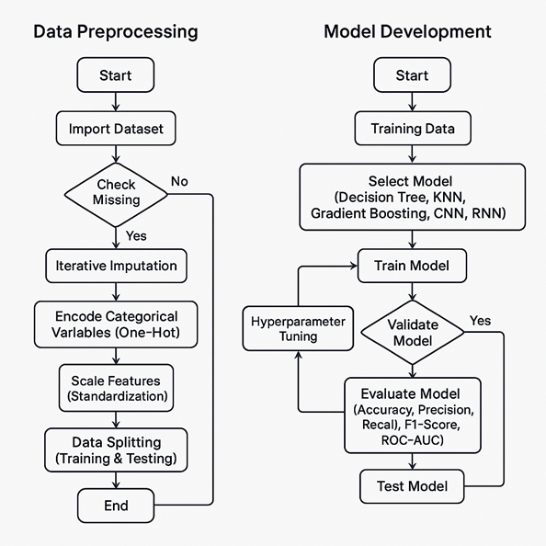

Data Preprocessing
Flowchart

Slide 7
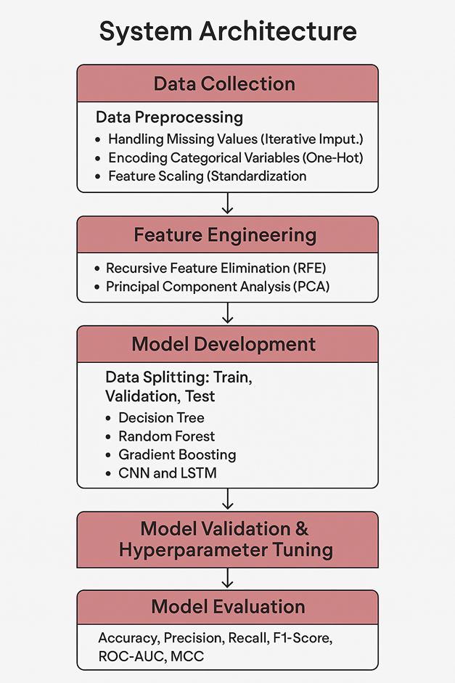
System Architecture
Diagram

Slide 8
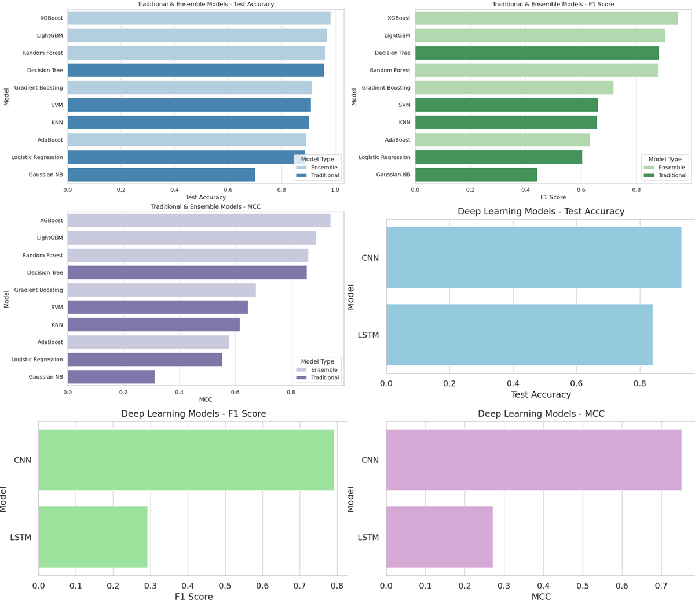


Evaluation Metrics
Accuracy: Overall percentage of correct predictions.
F1 Score: Harmonic mean of precision and recall — ideal for imbalanced data.
Matthews Correlation Coefficient (MCC): Best single-value metric for binary classification imbalance.
Also evaluated: Training time and prediction time for practical deployment considerations.

Slide 9
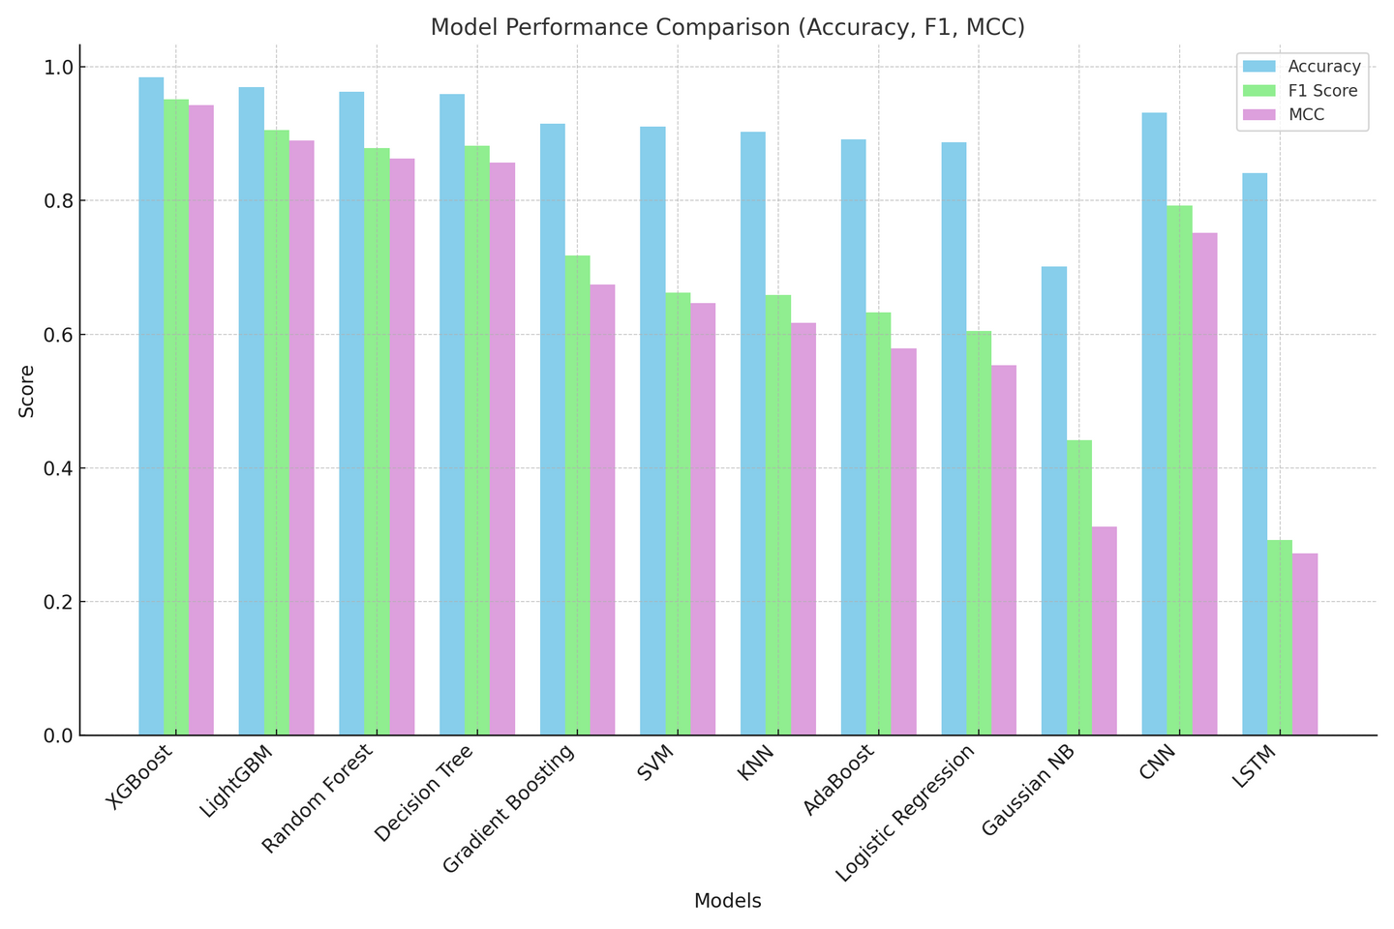
Results & Performance
XGBoost achieved the highest scores across all metrics: Accuracy = 98.4%, F1 = 0.9516, MCC = 0.9424.
CNN showed moderate performance (Acc = 93.16%), but LSTM underperformed (F1 = 0.29), indicating poor suitability for static tabular data.
These results suggest ensemble models outperform both traditional and deep learning techniques for this use case [3][4].

Slide 10
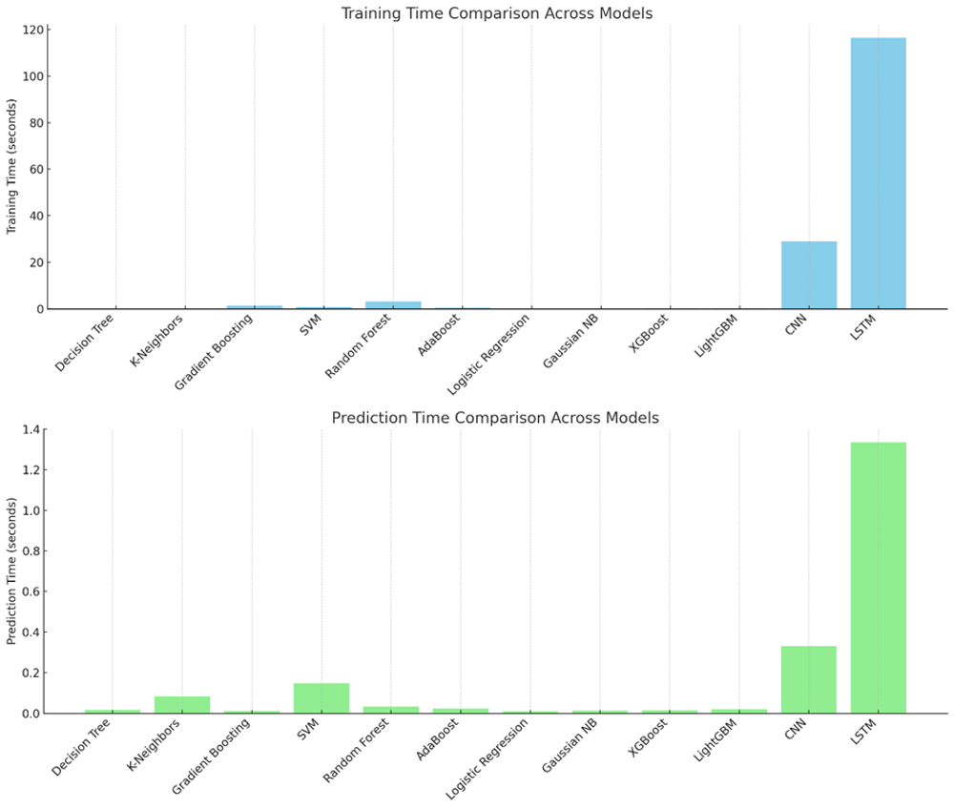
Efficiency & Statistical Testing
Training and inference times show XGBoost and LightGBM are highly efficient (training in <0.3s).
Deep models like LSTM required >100s to train and were not feasible for deployment.
Paired t-tests confirmed XGBoost significantly outperformed LightGBM in F1 Score (p=0.0219) and MCC (p=0.0398).
This validates the statistical robustness of performance differences.

Slide 11
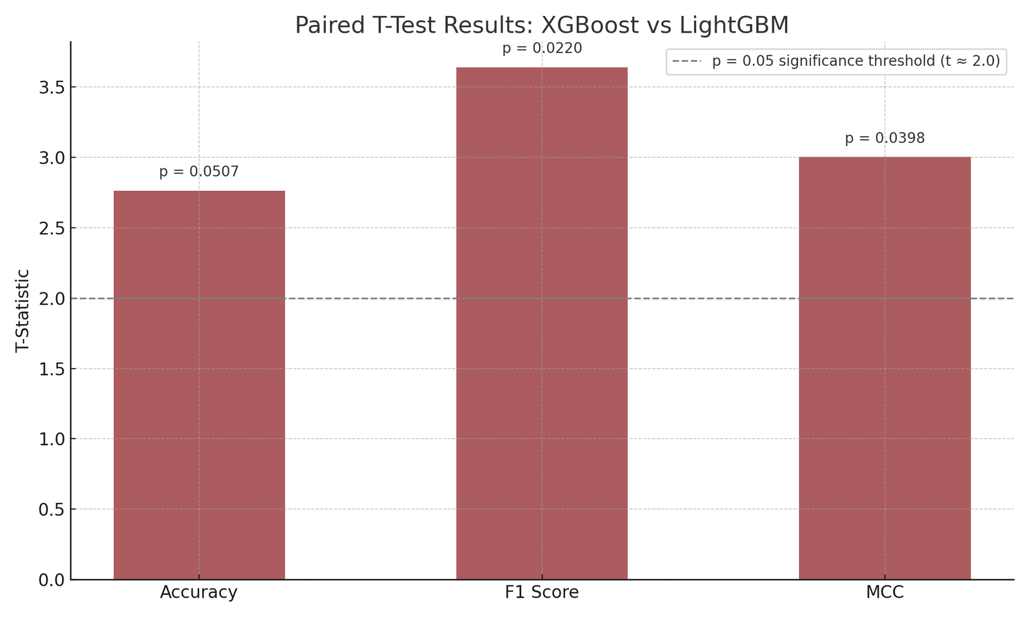
Efficiency & Statistical Testing

Slide 12

Recommendations
Real-World Deployment Guidance
Interpretability and Actionability
Integration Potential
XGBoost is the most suitable model for real-time churn prediction in e-commerce due to its high accuracy, MCC, and fast prediction time.
LightGBM is also a strong alternative when slightly faster training speed is prioritized.
Use SHAP (SHapley Additive exPlanations) to interpret predictions — helping business teams understand key churn drivers.
Enables personalized retention campaigns based on model insights (e.g., loyalty offers, satisfaction calls).
Easily integrated into existing CRM platforms (e.g., Salesforce, HubSpot) or custom dashboards using APIs.
Feasible for mid- to large-scale businesses with moderate computing infrastructure.

Slide 13
Future Work
Model Enhancement
Data Expansion
Integrate time-series features (e.g., transaction history over time) to improve the performance of sequential models like LSTM.
Explore hybrid architectures like CNN + XGBoost to combine pattern recognition and decision optimization.
Apply the model on multi-label churn levels (e.g., 'at risk', 'likely to churn', 'highly loyal') to refine retention strategies.
Use behavioral data (clickstream, session length) to enrich input features.
Explainability & Fairness
Comparative Benchmarking
Add LIME or SHAP to production models for transparency.
Investigate fairness across customer segments (e.g., age, gender) to avoid bias in churn prediction.
Benchmark against other domains (banking, telecom) to test generalizability.
Test on real-time data pipelines to evaluate performance under live conditions.

Slide 14


Conclusion
XGBoost demonstrated the best overall performance with an MCC of 0.9424, high interpretability, and low latency — making it optimal for churn prediction.
Ensemble models significantly outperformed deep learning in accuracy, efficiency, and deployability for tabular e-commerce data.
Statistical tests confirmed that XGBoost’s F1 Score and MCC advantages over LightGBM were statistically significant (p < 0.05).
This study provides a practical and evidence-backed roadmap for implementing predictive churn solutions in e-commerce environments.

Slide 15
Reference
[1] Reichheld, F.F. and Schefter, P. 2000. E-loyalty: Your secret weapon on the web. Harvard Business Review, 78(4), 105–113.
[2] Chevalier, J. 2024. Global e-commerce sales forecast. Global Business Insights, 13(4), 17–23.
[3] Kumar, R. 2022. Customer retention strategies in e-commerce. Journal of Business Economics, 94(2), 125–140.
[4] Raeisi, R. and Sajedi, H. 2021. Ensemble machine learning approaches for churn prediction in e-commerce platforms. International Journal of Computer Applications, 183(15), 22–28.
[5] Liu, Y., Chen, H. and Xu, K. 2023. Evaluating the efficiency of traditional vs. deep learning models in structured data prediction. Journal of Artificial Intelligence Research, 76, 90–108.

Slide 16
Thank You So Much!
CS Thesis
Presented by
Godfred Kogkane
Supervisor | Prof. Robert Sowah Adjetey

